Slide 1
Teacher agency and English language teaching in difficult circumstances
Richard Smith, University of Warwick

Slide 2
Download handout from here: telcnet.weebly.com/presentations or here:

Slide 3
Plan
ELT in difficult circumstances – where are we now / how have we got here?
Overview of some initiatives engaging / developing teacher agency (teacher autonomy)

Slide 4
1. Michael West’s Teaching English in Difficult Circumstances (1960, Longmans, Green)
“over 30 pupils (more usually 40 or even 50), congested on benches […,] ill-graded, with a teacher who perhaps does not speak English very well […], working in a hot climate.” (p. 1)
'The problem is one which has of late tended to become exacerbated owing to the rapid spread of education in these areas, too rapid for the supply of buildings and teachers to catch up with the number of pupils, and owing to the spread of education over a larger proportion of the population'. (ibid.)

Slide 5
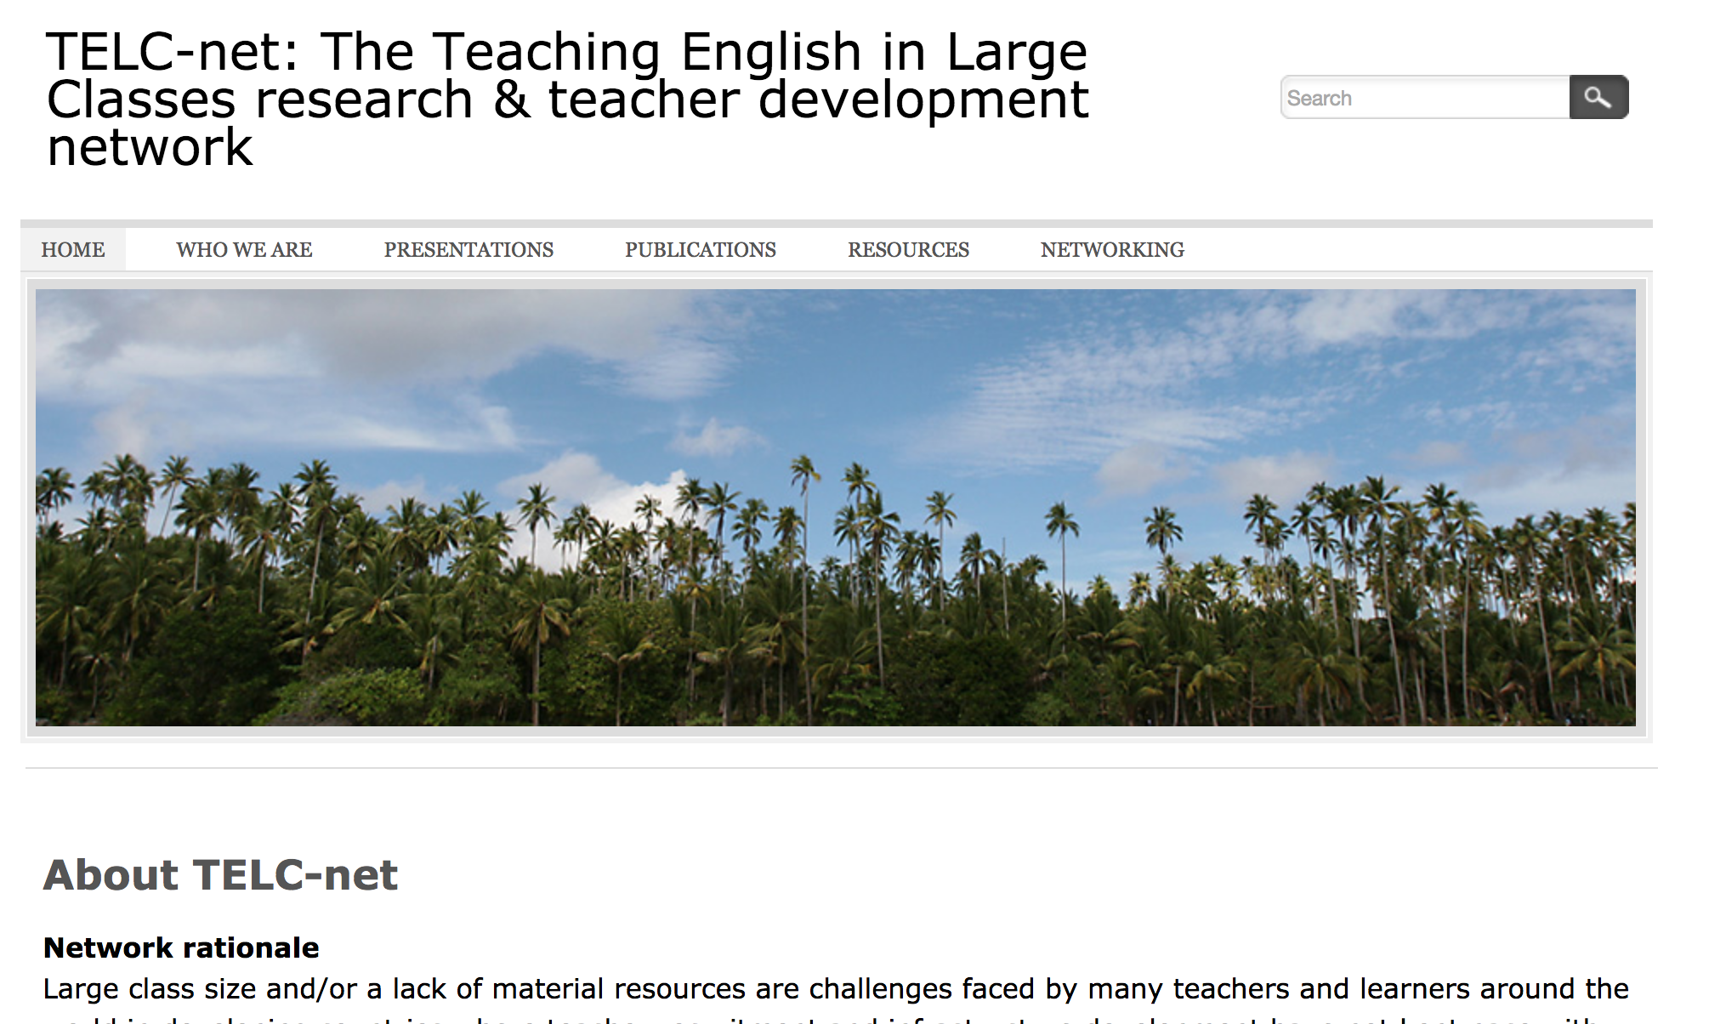
2. TELC-net: telcnet.weebly.com

Slide 6
3. From this …
[c. 1960? recording of Michael West] https://warwick.ac.uk/fac/soc/al/research/collections/elt_archive/halloffame/west/archive/2_teaching_english_under_difficult.mp3 (11:34 onwards)
to this …
[2007 recording of Harry Kuchah]
https://warwick.ac.uk/fac/soc/al/research/groups/llta/resources/telc/harry_kuchah_12.5.07_-_problems_only.mp3 (e.g. 2:10 onwards)

Slide 7
Download handout from here: telcnet.weebly.com/presentations or here:

Slide 8
5. TELCnet research
1) Leave behind conceptions of small-class teaching as norm and TiDC as a ‘problem’ –> start with descriptions of practice, in particular ‘good practice’ as perceived by participants
2) Focus on issues of practical concern to teachers themselves – support teachers to develop appropriate methodology ‘from the bottom up’, for example through practitioner research.
3) Qualitative, exploratory ‘case study’ / narrative approach
(Smith 2011)

Slide 9
6. Some early publications
Shamim, F. 2010. 'Plenary: Teaching and researching English in large classes'. In Beaven, B. (ed.) IATEFL 2009: Cardiff Conference Selections. Canterbury: IATEFL, pp. 36-47.
Smith, R. 2011. 'Teaching English in difficult circumstances: A new research agenda'. In Pattison, T. (ed.) IATEFL 2010 Harrogate Conference Selections. Canterbury: IATEFL.
Phyak, P.B. 2011. 'Teaching English in large multicultural classes: a narrative enquiry'. In Pattison, T. (ed.) IATEFL 2010 Harrogate Conference Selections. Canterbury: IATEFL.
Kuchah, K. and Smith, R. 2011. ‘Pedagogy of autonomy for difficult circumstances: From practice to principles’. Innovation in Language Learning and Teaching 5/2: 119-139.

Slide 10
7. Plenary talks (TiDC mainstreamed?)
NELTA (2013): Smith, R. 2014. ‘Transformations in ELT: Agents, contexts and opportunities’. In Shrestha, P.N., Dhakal, K.R., Ojha, L.P., Rana, L.B., and Rawal, H. (eds) NELTA Conference Proceedings 2013. Kathmandu, Nepal: Nepal English Language Teachers’ Association, pp. 12-22. Pre-publication version
CAMELTA (2013): ‘Teacher-research in difficult circumstances’ → ‘CAMELTA Research in your circumstances’. Cf. Smith, R. and Kuchah, K. 2016. 'Researching teacher associations'. ELT Journal 70/2: 212-221.
IATEFL (2015): Kuchah, K. 2016, ELT in difficult circumstances: challenges, possibilities and future directions. in T Pattison (ed.), IATEFL 2015 Manchester Conference Selections . Faversham: IATEFL

Slide 11
8. Fast forward >>>> Two recent publications
Smith, R., Padwad, A. and Bullock, D. (eds.) 2017. Teaching in Low-resource Classrooms: Voices of Experience. London: British Council. Accompanying video resource: http://www.teachingenglish.org.uk/low-resource-classrooms
Kuchah, K. and Shamim, F. (eds) 2018. International Perspectives on Teaching English in Difficult Circumstances: Contexts, Challenges and Possibilities.﻿ Basingstoke: Palgrave Macmillan.

Slide 12
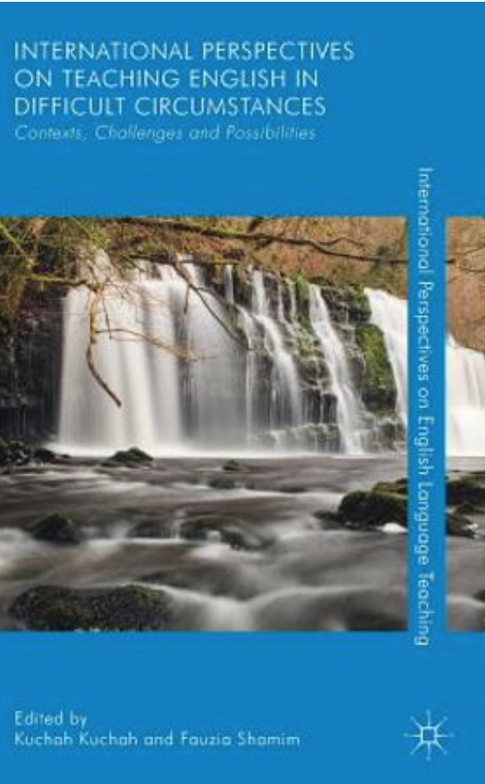

Slide 13
9. Some recent/ongoing projects
Exploratory Action Research:
British Council Champion Teachers Project (Latin America) and AARMS (India and Nepal) (cf. Smith, R. and Rebolledo, P. 2018. A Handbook for Exploratory Action Research. London; British Council
‘Teacher-research for Difficult Circumstances’ http://warwick.ac.uk/trdc; International Festival of Teacher-research in ELT: https://trfestival.wordpress.com/)

Slide 14
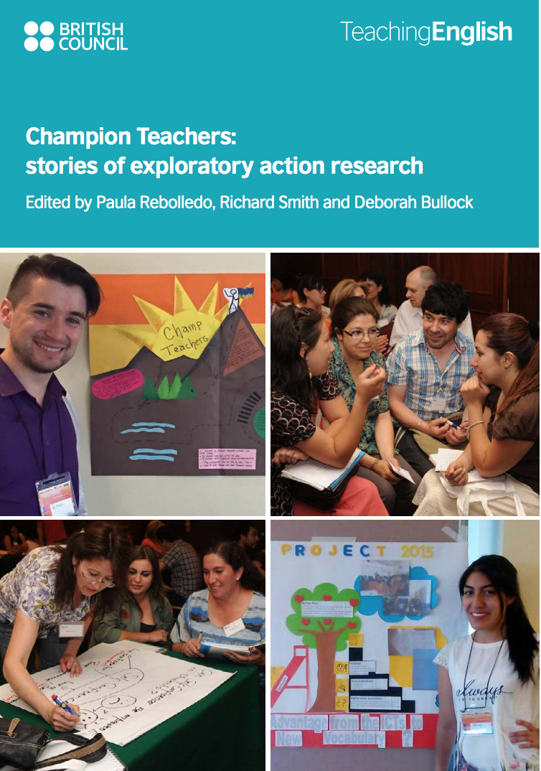

Slide 15
TA-Research (in CAMELTA and NELTA):
cf. Kuchah, K. and Smith, R. 2018. 'An invitation to Teacher Association Research'. English Language Teacher Education Journal. 21: 64–71.

Slide 16
Children and Teachers as Co-researchers:
Pinter, A., Mathew, R. & Smith, R. 2016. Children and Teachers as Co-researchers in Indian Primary English Classrooms. London: British Council. Online (Open Access).

Slide 17
10. Learner autonomy – and teacher autonomy / teacher agency – in difficult circumstances
Smith, R. with Simla Course. 2014. 'Teacher development, teacher-research, and autonomy'. Independence 61. Pre-publication version
Smith, R. with Laxmi Pd. Ojha. 2015. 'Teaching English in difficult circumstances: a conversation'. NELTA ELT Forum (July 2015). [The entire issue is devoted to 'Teaching English in difficult circumstances']
Smith, R., Kuchah, K. and Lamb, M. 2018. 'Learner autonomy in developing countries'. In Chik, A., Aoki, N. and Smith, R. (eds). Autonomy in Language Learning and Teaching: New Research Agendas. London: Palgrave Pivot.

Slide 18
A language is learnt rather than taught, and too much teaching can be an obstacle to learning
(Michael West, lecture recording on Warwick ELT Archive website: https://warwick.ac.uk/fac/soc/al/research/collections/elt_archive/halloffame/west/extracts/)

